Slide 1
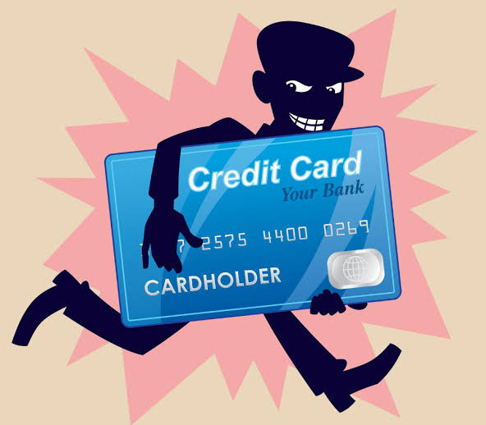
Credit card fraud detection system
1828214 Swati Thakur
1828217 Utkarsh Jaiswal
1828218 Vikash Kumar
Under Guidance of Prof. Lalit Vashishtha

Slide 2
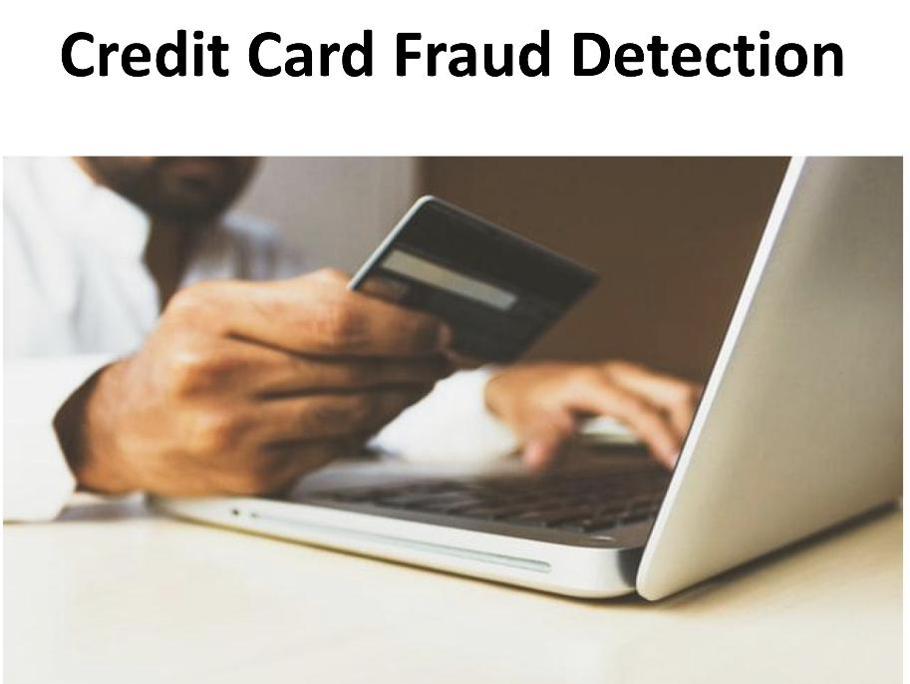

Overview

Slide 3
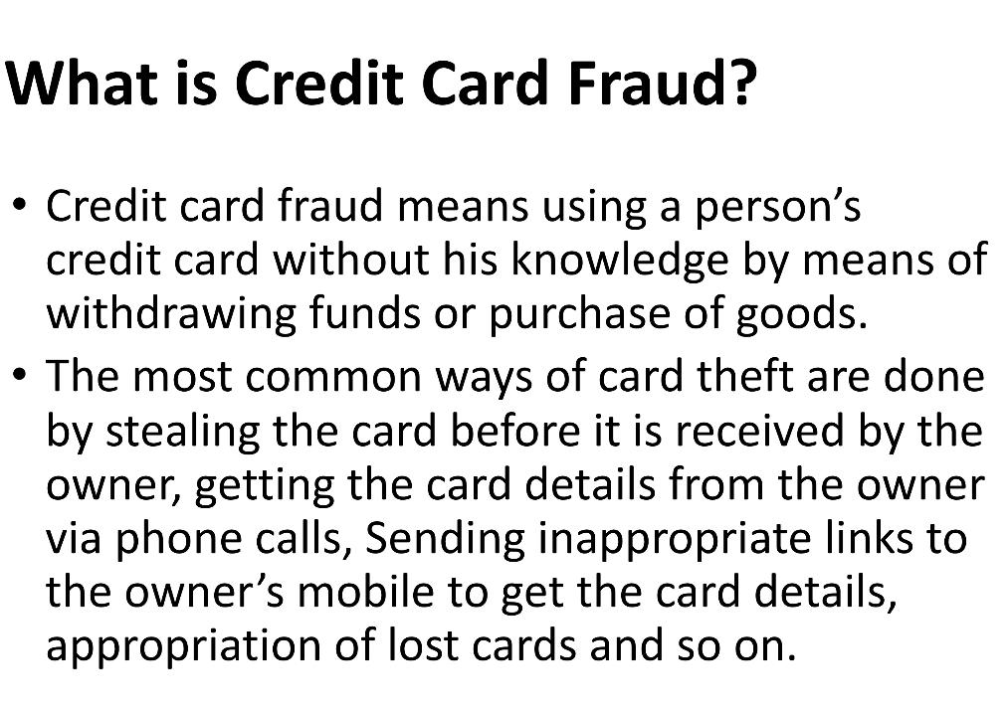

Slide 4
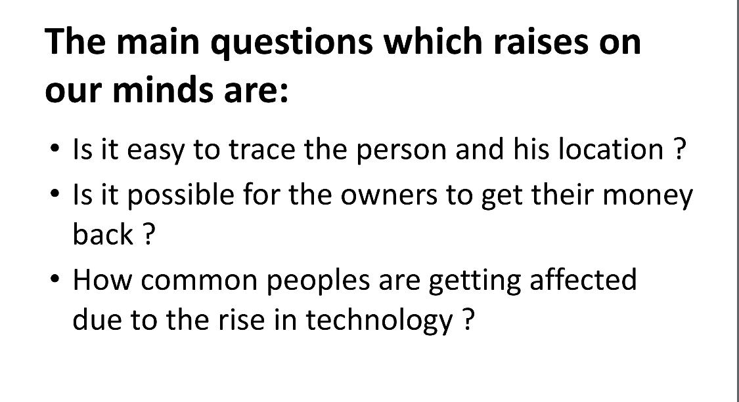

Slide 5
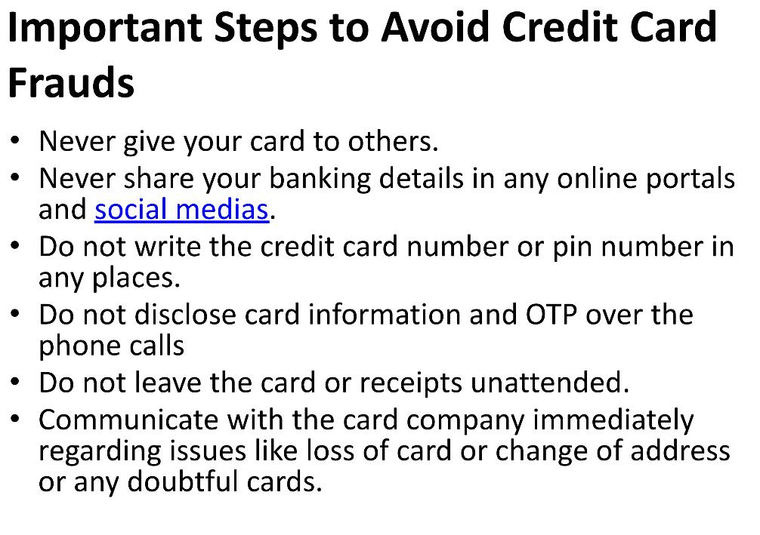


Slide 6
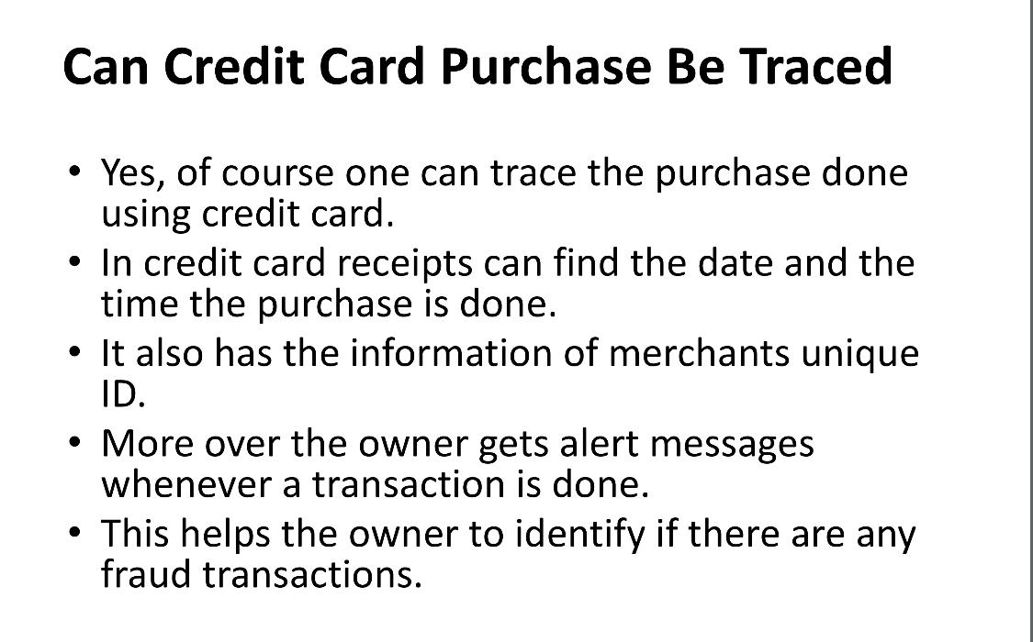


Slide 7
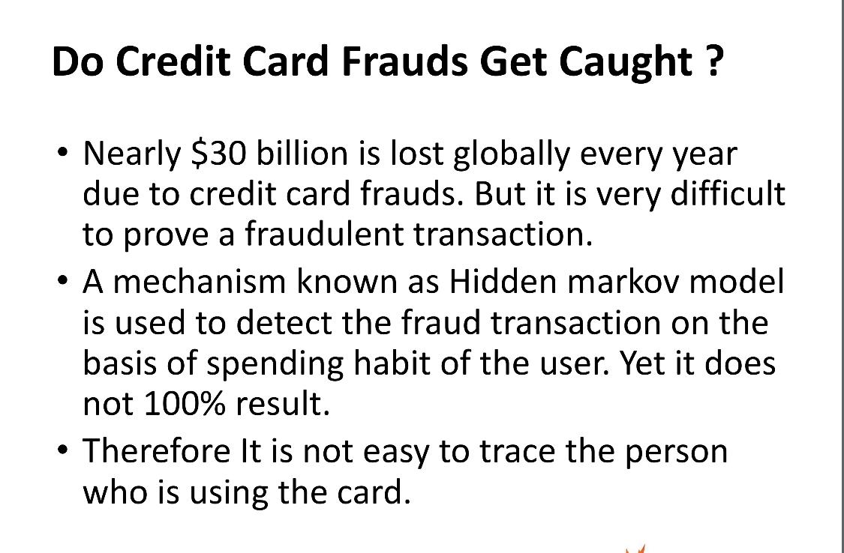
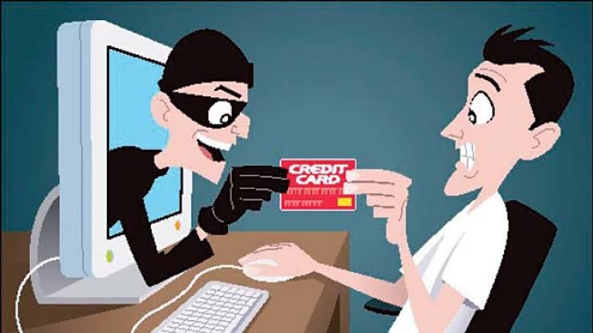

Slide 8
Conclusion

Slide 9
